Slide 1
Group 4 DHIS2 Insights and Analysis
By: Harsh Patel, Kalp Patel, Deepishka Pemmasani, Surya Tejaswi Mallidi, Poorva Reddy Vanga, Pallavi Vandanapu, and Bhavana Bethi

Slide 2
For 2023, Compare the Maternal death rate by registered live birth for the eastern-Chiefdoms to the western-Chiefdoms. Name the chiefdom with the highest maternal death rate. Name its surrounding chiefdoms with low maternal death rate.

Slide 3
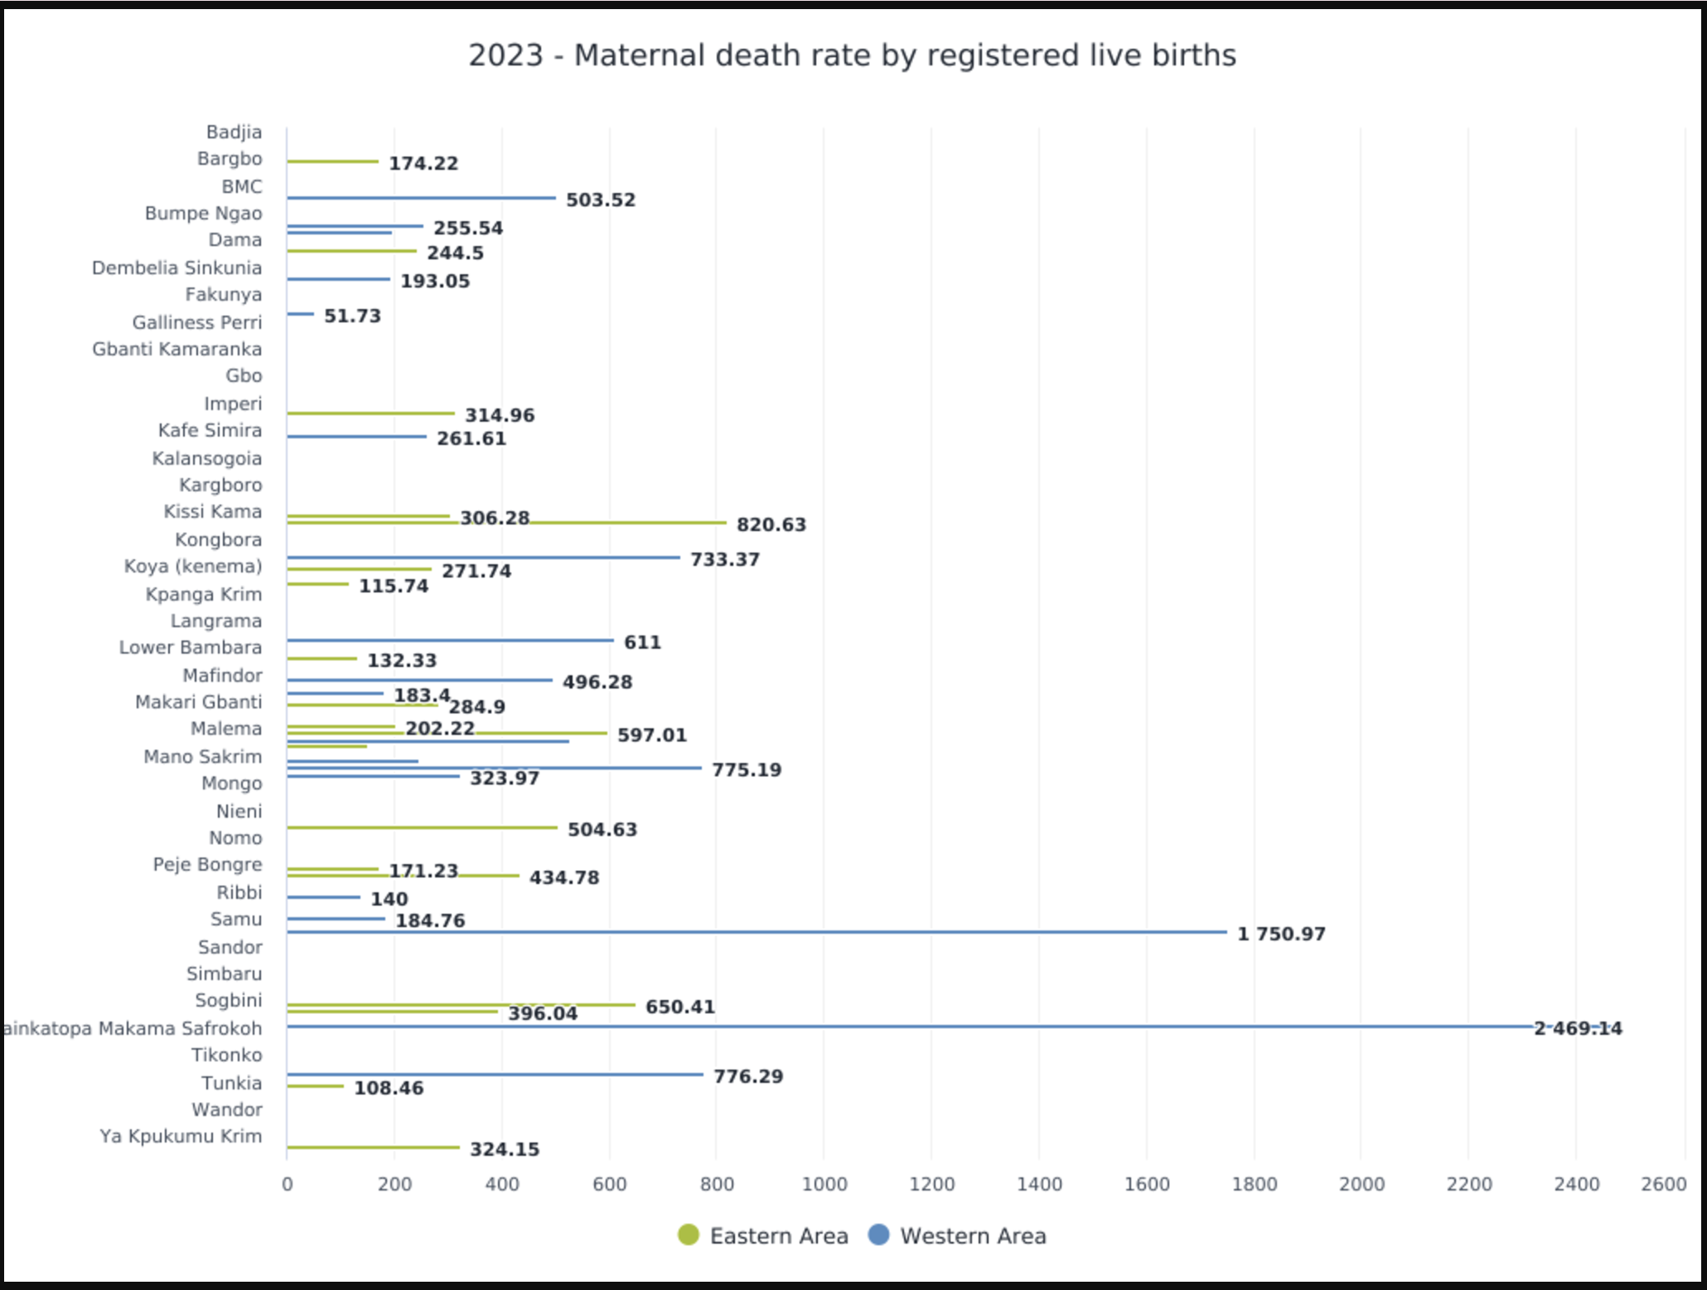
Indicator : Maternal death rate by registered live birth
Fixed period - yearly - 2023
Sierra Leone - level = Chiefdom
Eastern area and Western area
Column graph
Data
Period
Organization
Area
Visualization
Configuration
Series = Area, Category = Organization, Filter = Period and data

Slide 4
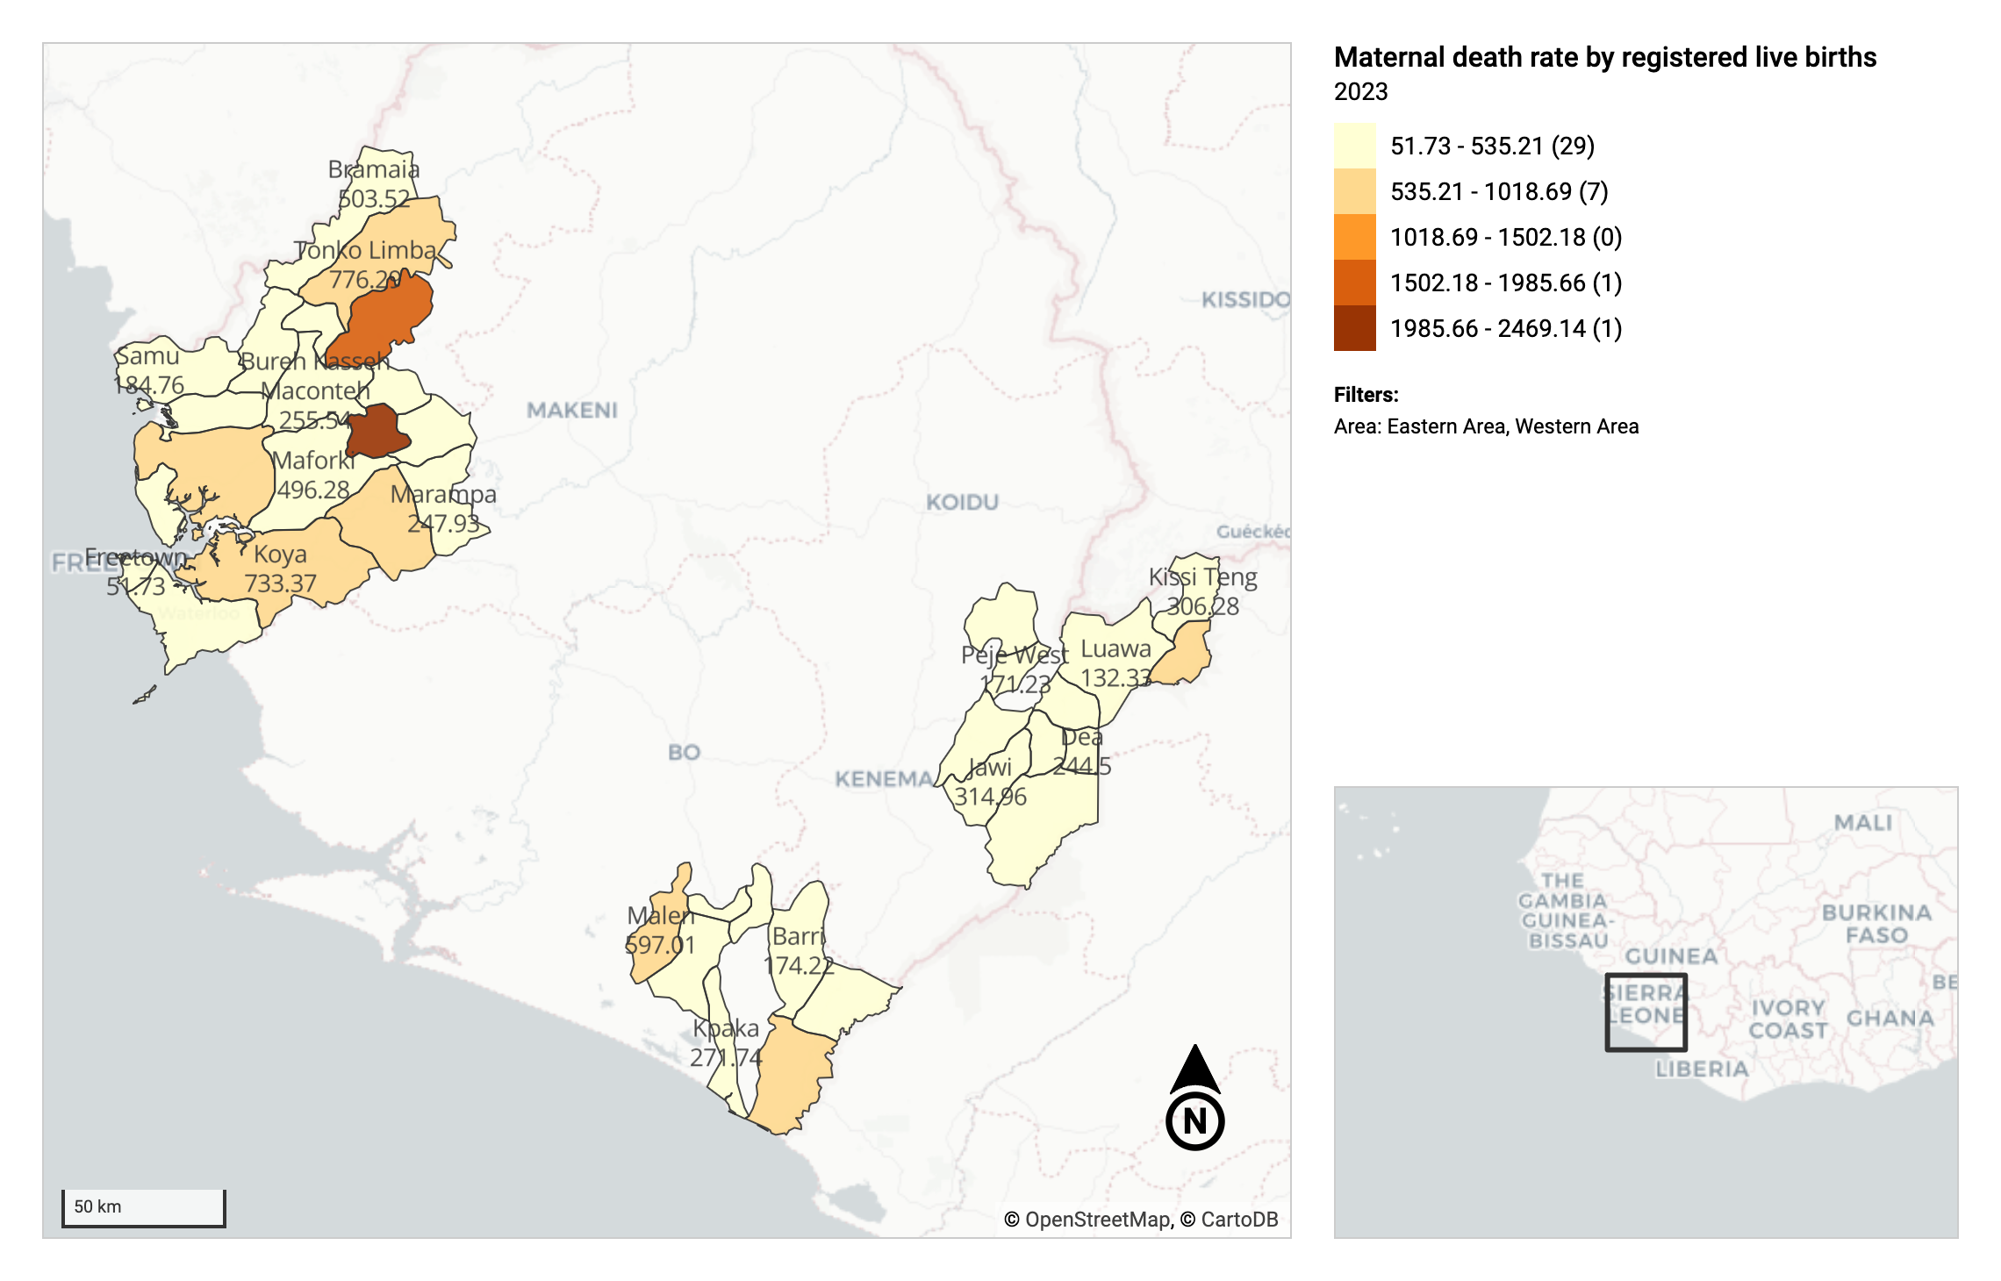
Chiefdoms with the Highest Maternal Death Rate by live births is Tainkatopa Makama Safrokoh (Western Chiefdom).
Value = 2469.14

Slide 5

Analysis
Within Western Chiefdoms, Tainkatopa Makama Safrokoh has the highest Maternal Death Rate with value = 2469.14
1.Bureh Kasseh Maconteh: 255.54 per registered live birth
2. Maforki: 496.28 per registered live birth
3. Buya Romende: 198.41 per registered live birth
4. Dibia: 193. 05 registered live birth
5. Marampa: 247.93 per registered live birth

Slide 6
For the 2023 and 2024 monthly data for the above indicator, using 3-month and 5-month moving averages, can you predict the values of the indicator in January 2025 for the chiefdom with the highest maternal death rate? Which is the better of the two models when compared to the actual values of 2024?

Slide 7
After following the steps mentioned in slide 1, modify period to include monthly data for 2024 and add period to rows and select Pivot table and download CSV.
In R, select organisationunitname = Tainkatopa Makama Safrokoh
Calculate MAE and RMSE for both models
Predict values for January 2025.
Missing values imputed with linear interpolation.
Calculate 3-month and 5-month moving averages on interpolated values

Slide 8
Describe the indicators (with all the internal details) that were used to answer Q1.
Indicator name: Maternal death rate by registered live births
• Description: Ratio of Maternal deaths by 100000 registered live births.
• Numerator: Maternal Death
• Description: The annual number of female deaths from any cause related to or aggravated by pregnancy or its management (excluding accidental or incidental causes) during pregnancy and childbirth or within 42 days of termination of pregnancy, irrespective of the duration and site of the pregnancy.
• Denominator: Registered live births
• Description: The complete expulsion or extraction from its mother a product of human conception, irrespective of the duration of pregnancy, that, after such expulsion or extraction, breathes or shows any other evidence of life such as beating of the heart, pulsation of the umbilical cord or definite.
• Indicator type: Per hundred thousand

Slide 9
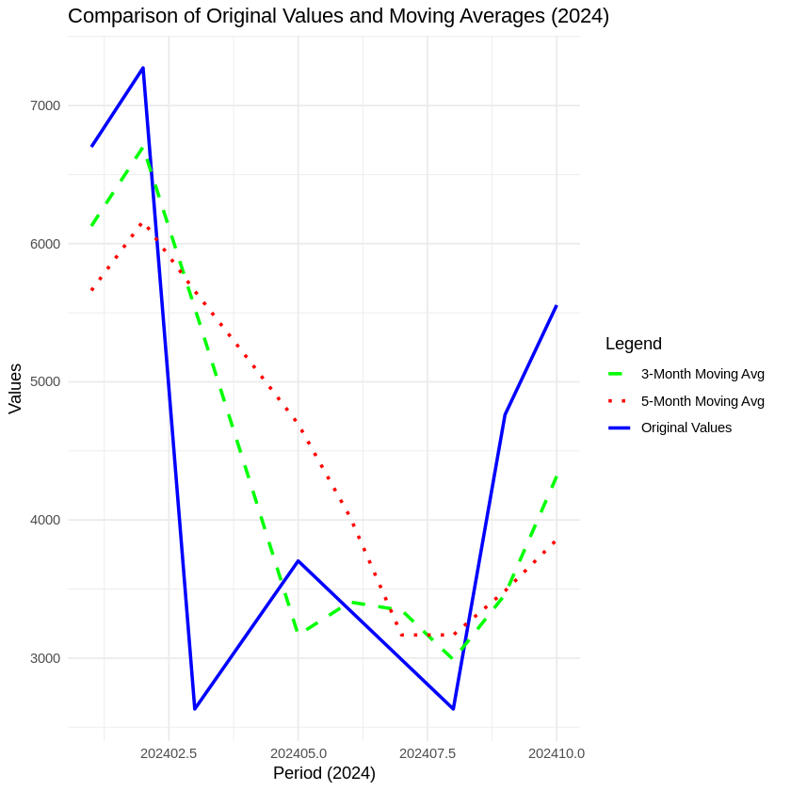
Interpretation
MAE_3M | RMSE_3M | MAE_5M | RMSE_5M
1151.571 | 1437.611 | 1439.564 | 1641.697
Predicted values for January 2025
3-Month Moving Average | 4316.347
5-Month Moving Average | 3856.864

Slide 10
What can you say about the BCG coverage rate of children less than 1yr around the beaches of the capital city of Sierra Leone based on data for the last 18 months? Present a tabular representation of this data for all the health centers in the western area.

Slide 11
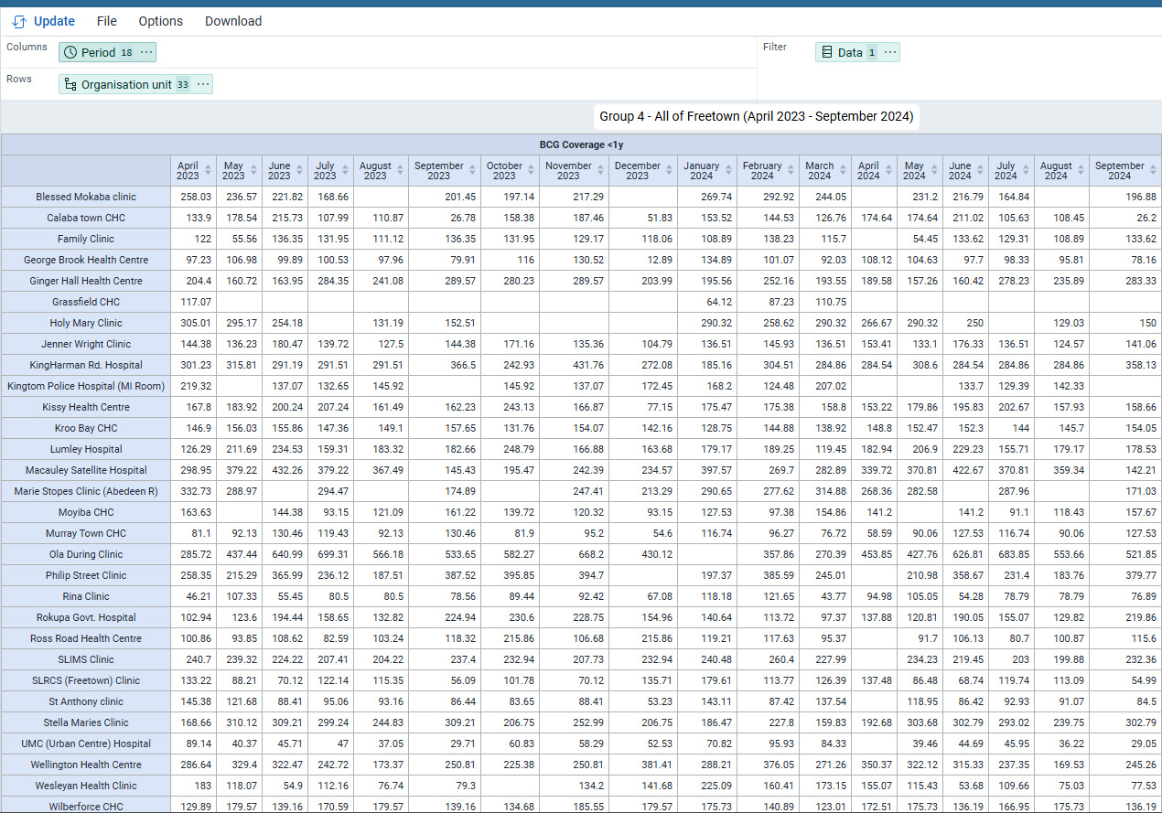
Columns – (Period): April 2023 – December 2023 (9 months) + January 2024 – September 2024 (9 months). Which makes the total of 18 months.
Filter – (Data): BCG Coverage <1 year.
Rows – (Organisation Unit): Selected 31 health facilities in Freetown (Western Area) by facility level and Western Area group.
Exclusions: Removed health centers with no data; excluded November & December 2024 due to missing data.
Outcome: Generated a pivot table showing BCG coverage for children under 1 year in Freetown’s beaches over the past 18 months.

Slide 12
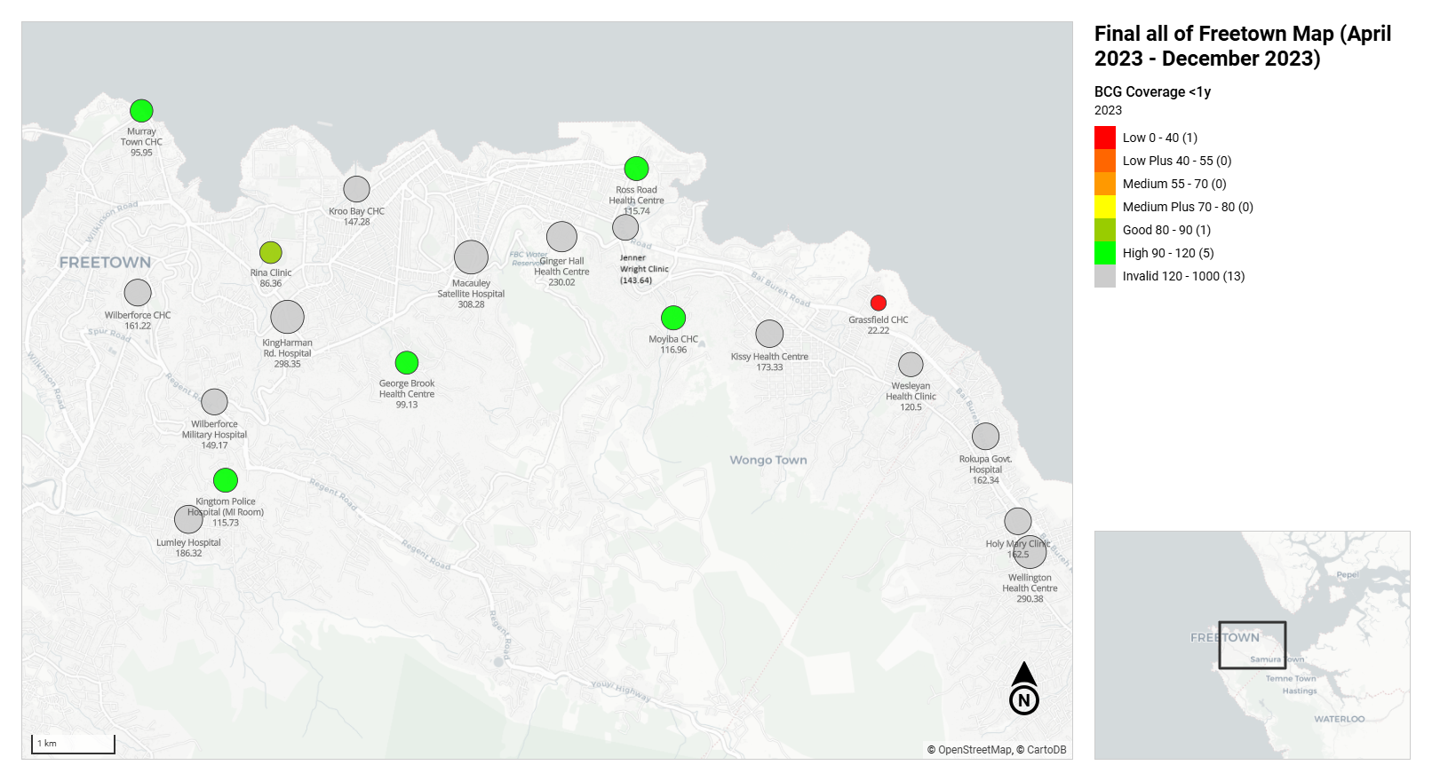
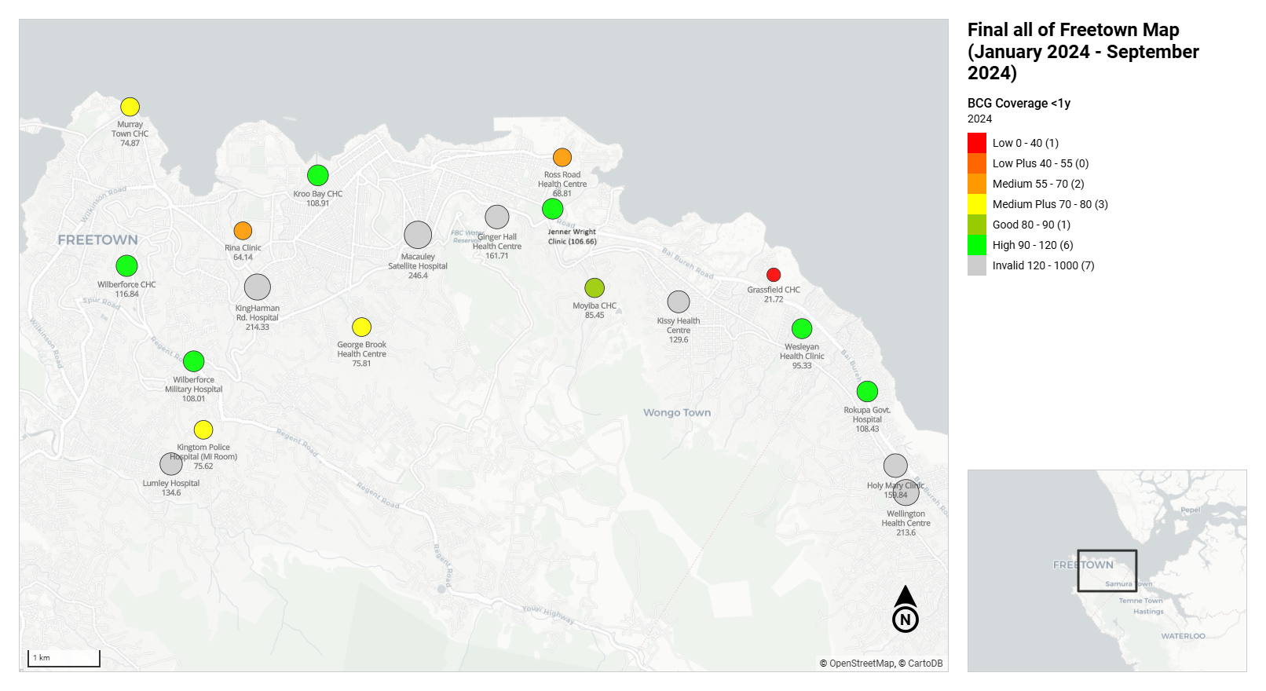
BCG Maps 2023 vs 2024
Challenge: The pivot table alone didn’t provide a clear visual of which health centers around the beaches were affected.
Solution: Created 2 maps using the pivot table data to visualize BCG coverage for children under 1 year.
Map 1: BCG coverage for April 2023 – December 2023 (9 months)
Map 2: BCG coverage for January 2024 – September 2024 (9 months)
Note: DHIS2 did not allow for specific start and end dates due to unknown data recording days. Hence the reasoning for creating 2 maps.
BCG Coverage Rate (2023 vs 2024): BCG coverage for children under 1 year old at Western Area health centers decreased between 2023 and 2024. The largest decreases were observed at Wilberforce CHC, Kissy Health Centre, and Rokupa Govt. Hospital.
Data Quality Improvement: The 2023 map showed a large "Invalid 120-1000" category, indicating unreliable data. In 2024, more detailed coverage categories were used, suggesting improved data collection and measurement processes between the two years. This improved granularity and reliability of the 2024 data compared to 2023 makes it a more valuable source of information for understanding the vaccination coverage trends in the region.

Slide 13
Give the underlying data elements/categories/category combinations that were used for analysis in Q.3. Perform correlation analysis using values of the data elements for all the health centers in the Western area, and interpret the analysis.

Slide 14
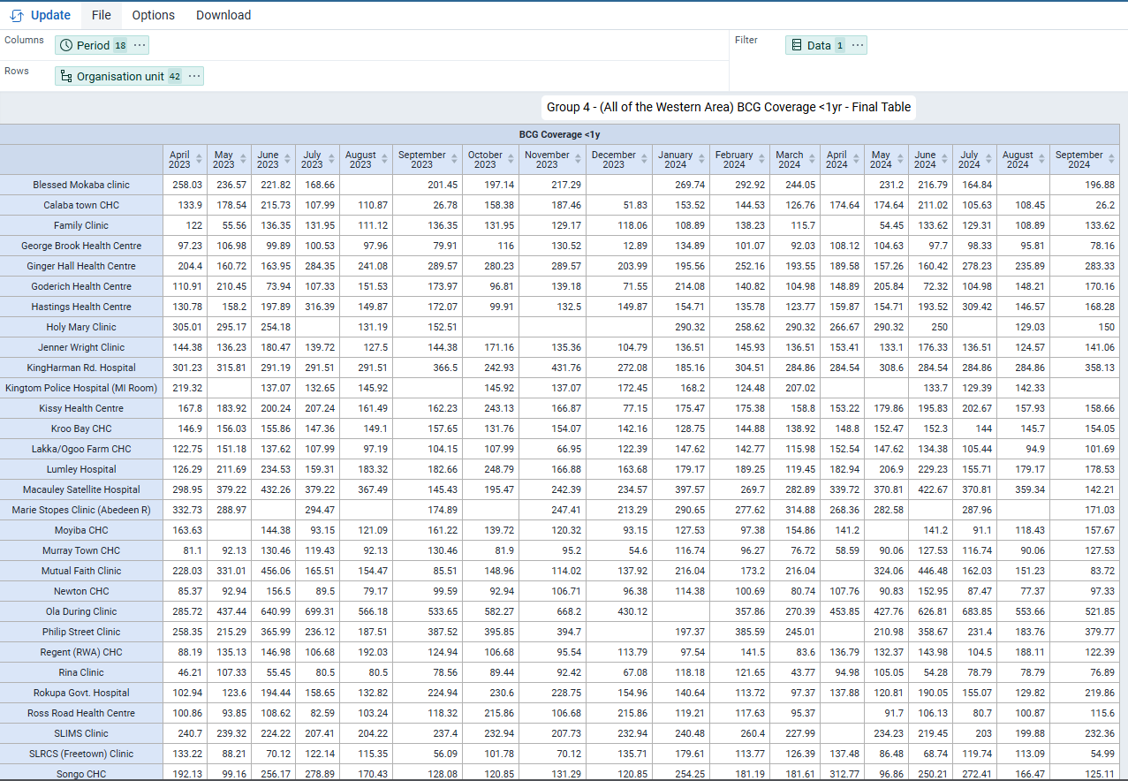
Secondary Pivot Table
Expansion: Created a secondary pivot table with the same dimensions, but included additional data from the Rural Western Area.
Selected Health Centers: Added 10 health centers from the Rural Western Area: Goderitch Health Centre, Hastings Health Centre, Lakka/Ogoo Farm CHC, Mutual Faith Clinic, Newtown CHC, Regent (RWA) CHC, Songo CHC, Tombo CHC, Waterloo CHC, and York CHC, all with data from April 2023 – September 2024.
Purpose: This final pivot table was used for analysis in question 4. Because this data includes all of the health centers in the western area.

Slide 15
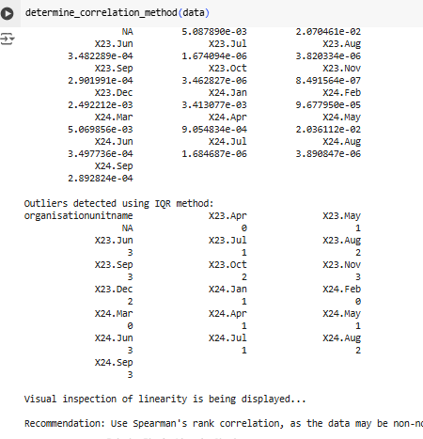
Data Preparation and Analysis
Data Source: Downloaded “BCG Coverage All of Western Area.csv” for analysis, including both Freetown and Rural Western Area health centers.
Data Preparation: Handled missing values through linear interpolation. Estimating the missing values between known data points.
Normality Check: Used Shapiro-Wilk test; data did not follow a normal distribution.
Linearity Check: Performed visual inspection of linearity. It wasn’t normally distributed.
Correlation Method: Recommended Spearman’s rank correlation due to non-normal distribution and potential outliers. Spearman’s is robust to outliers, as it relies on rank order rather than raw values, ensuring accurate insights despite extreme values.
Outliers: Retained in the analysis as Spearman’s correlation is less affected by outliers and reflects overall trends. Even with presence of outliers, Spearman’s correlation can still provide reliable insights into the general relationship between variables.

Slide 16
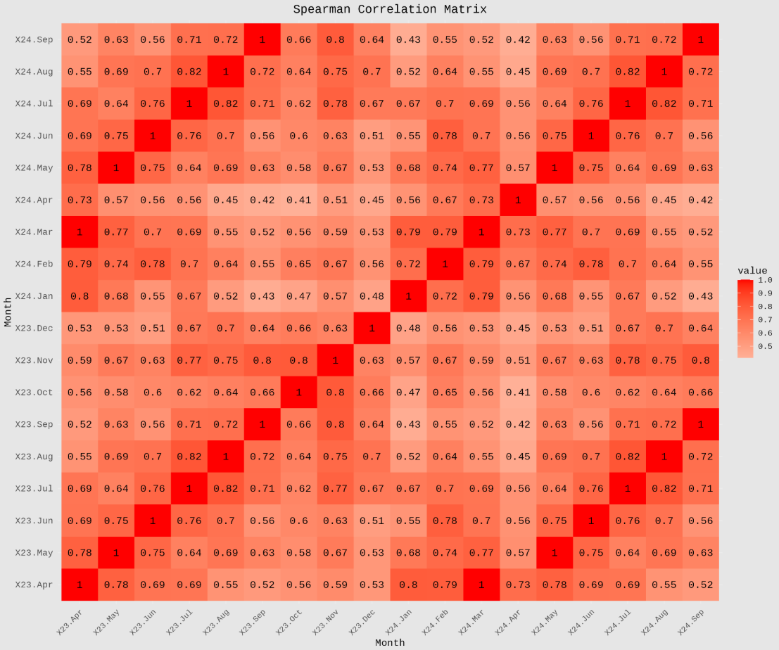
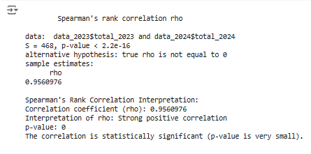
Data Analysis Summary
Correlation Matrix Insights:
Strong positive correlations between most health centers indicate similar BCG coverage trends.
Some negative correlations suggest inverse patterns between certain health centers.
The Spearman p-value (< 2.2e-16) is highly significant, showing that the correlations are unlikely to occur by chance.
Overall, BCG coverage in the Western Area health centers tends to move together, with underlying factors influencing the trends.
Spearman's Correlation Results:
Strong positive correlation (ρ = 0.956) between 2023 and 2024 BCG coverage.
Suggests consistent vaccination efforts across health centers in Western Area, with minimal variation over time.
Statistically significant p-value supports the reliability of the findings.

Slide 17
Describe the trends of Reporting rates for the following datasets in all the districts of Sierra Leone by months for available data on:
EPI Stock
HIV Pediatric monthly

Slide 18
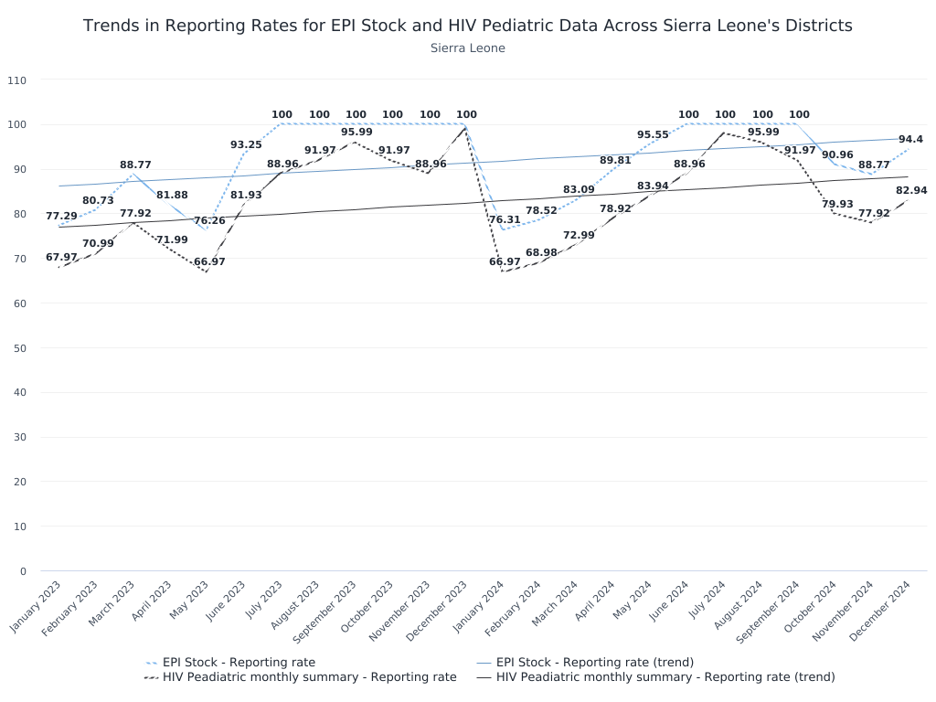
Trends in Reporting Rates for EPI Stock and HIV Pediatric Data
EPI Stock - Reporting Rate
Upward trend throughout the period.
January 2023: 77.29%.
April to October 2023: Reached 100% consistently.
November 2023: Slight decline to 94.4% but remains high.
HIV Pediatric Monthly Summary - Reporting Rate
Started lower at 67.97% in January 2023.
Dipped to its lowest point at 66.97% in April 2023.
October 2023: Reached 100% peak.
November 2023: Declined slightly to 88.77%.
Both datasets show positive trends over time.

Slide 19
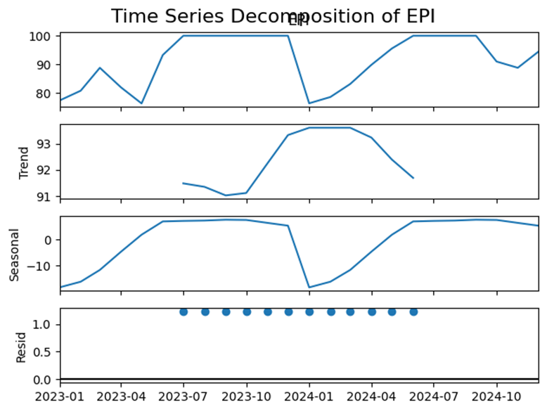
Four components of time series of EPI-Reporting Rates
Trend
Indicates long-term periodic growth and recovery.
Upward movement in early 2023, peaking at 100% in mid-2023.
Declines afterward, with partial recoveries in 2024.
Upward trend seen
Seasonality
Regular peaks and troughs suggest seasonal influence.
High reporting rates in mid-year, lower rates toward year-end.
Cyclicity
Is not clearly distinguishable over this two-year period.
Noise: There is variability in the data, such as the dips in early 2023 and late 2024, indicates random fluctuations not explained by trend or cyclicity.

Slide 20
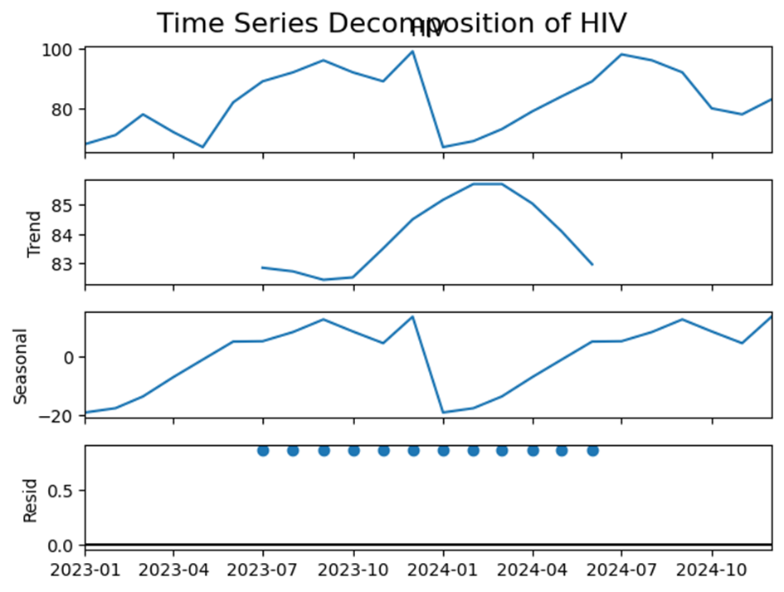
Four components of time series for HIV Pediatric Monthly :
Trend
Long-term periodic growth and recovery observed.
Peaks in mid-2023 and mid-2024 (~100%).
Declines in late 2023 and late 2024, followed by partial recoveries.
Overall upward trend
Seasonality
Regular peaks and troughs suggest seasonal patterns.
Peaks during mid-year; troughs at year-end.
Likely influenced by calendar-driven factors like reporting cycles.
Cyclicity
Cyclic patterns are absent in this data.
Noise
Abrupt dips and recoveries, e.g., early 2024, indicate random fluctuations.
This analysis takes into account 24 months of data, which helps us understand seasonality in the two data elements.

Slide 21
MODEL
Data Preprocessing:​
Checked for missing values and renamed columns for consistency.​
Performed Augmented Dickey-Fuller (ADF) test: Data was non-stationary (failed to reject null hypothesis)
Model Selection:
Narrowed down to SARIMA, Holt-Winters, and ETS due to clear seasonality observed in ACF plots and time decomposition.
Ruling out Auto ARIMA and Linear Holt’s models due to seasonality
Model Building:
Split data: 80% training, 20% test.
Built SARIMA, ETS, and Holt-Winters models.
Evaluation:
Compared models using RMSE, MAE, MAPE, and residuals (ACF).
SARIMA: Best fit, handled differencing well, low ACF in residuals.
ETS: Good metrics but constant point forecasts indicated poor performance for trend.
Holt-Winters: Struggled with seasonality due to linear trend assumption and large errors.

Slide 22
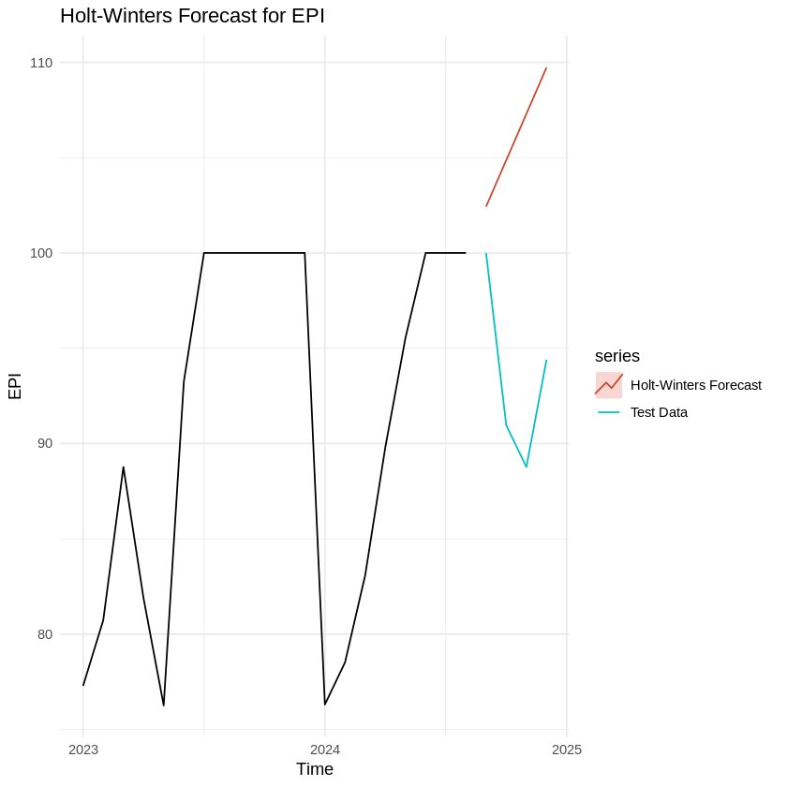
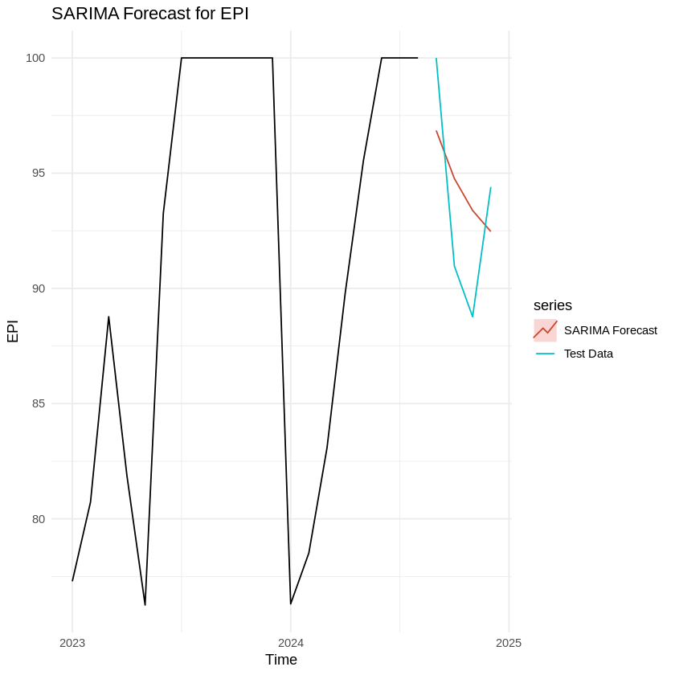
EPI STOCK REPORTING RATE MODEL
Metric | Holt Winters(Training) | Holt Winters(test) | SARIMA (Training) | SARIMA (Test)
ME | -1.8188 | -12.5462 | 0.611 | -0.8324
RMSE | 7.8879 | 13.9396 | 7.2177 | 3.5139
MAE | 5.2426 | 12.5462 | 5.6532 | 3.3746
MPE | -2.3975 | -13.7048 | -0.0069 | -1.044
MAPE | 6.1 | 13.7 | 6.5 | 3.64
MASE | 0.979 | 2.3429 | 1.0557 | 0.6302
ACF1 | 0.0459 | 0.0746 | 0.1455 | -0.2372
Theil's U | NA | 2.6633 | NA | 0.5929

Slide 23
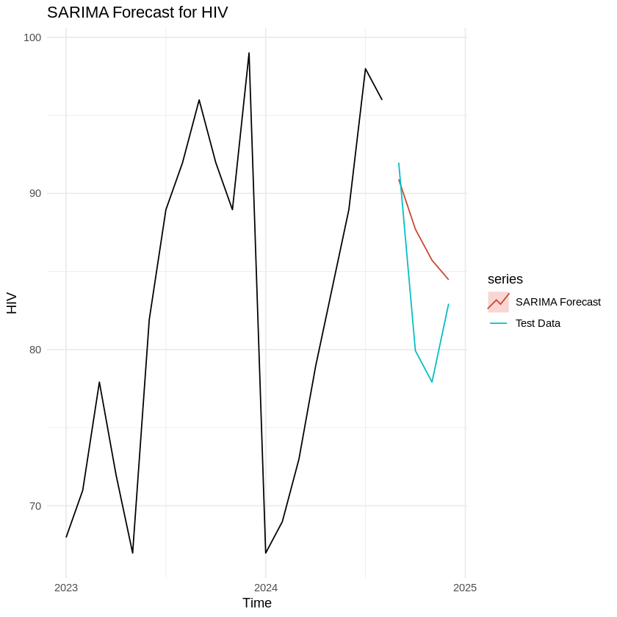
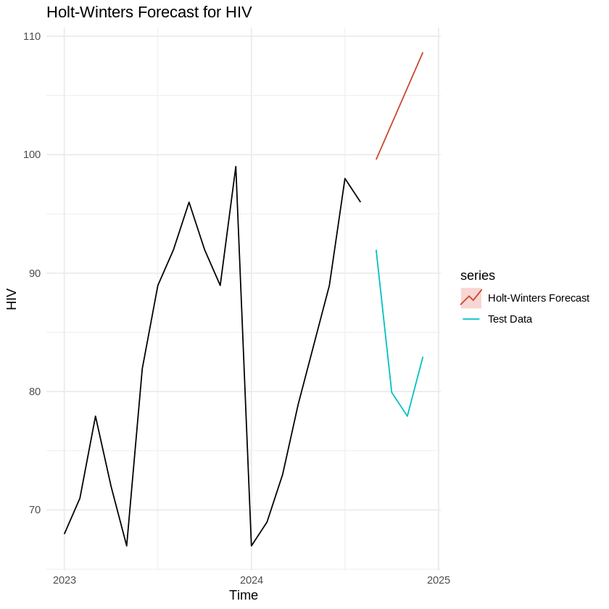
HIV Pediatric monthly
Metric | Holt-Winters (Training) | Holt-Winters (Test) | SARIMA (Training) | SARIMA (Test)
ME | -1.8495 | -20.9295 | 0.6099 | -4.0129
RMSE | 9.3243 | 22.3674 | 8.7542 | 5.5897
MAE | 6.0601 | 20.9295 | 6.6864 | 4.5488
MPE | -3.0751 | -25.8045 | -4.0541 | -5.11
MAPE | 7.8883% | 25.8045% | 8.4663% | 5.6926%
MASE | 0.9338 | 3.2249 | 1.0303 | 0.7009
ACF1 | -0.0342 | 0.0842 | -0.2303 | -0.2356
Theil's U | NA | 3.6363 | NA | 0.8827

Slide 24
Comparison and Best model:
For EPI Stock reporting rates:
Accuracy: The SARIMA model outperforms Holt-Winters in all key metrics for the test set, particularly in terms of RMSE, MAE, and MAPE.
Error Reduction: SARIMA shows significantly lower errors, suggesting it provides more reliable forecasts for the EPI stock.
For HIV Pediatric monthly:
Accuracy: The SARIMA model shows a clear advantage with lower RMSE, MAE, and MAPE values for the test set.
Error Reduction: SARIMA’s substantially lower errors suggest it is more accurate and reliable for HIV forecasting.

Slide 25
Compare the 3 facility infrastructure indicators for the last year, between the chiefdoms inside Bo district and Western Area districts. Use an area chart to display the visualization. What are other better ways to visualize this and why?

Slide 26
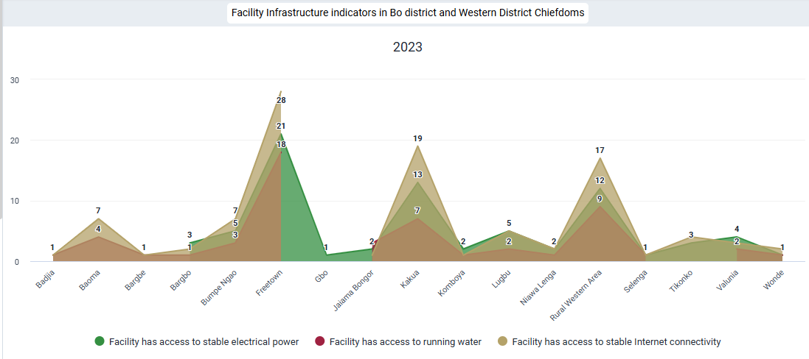
Data: "Indicator"
o “Public facilities with access to running water”
o “Public facilities with access to stable electric power”
• Period:
o Last year
• Organization Unit:
o Chiefdoms of Bo and Western Area
o Level: Chiefdoms
o Group: District
• Visualization:
o Area Chart
• Configure:
o Series: Organizational Unit
o Category: Data
o Filter: Period
“Public facilities with access to Internet connectivity”
Area chart comparing facility access to stable electrical power, running water, and stable Internet connectivity across chiefdoms of Bo district and Western Area district in 2023. Freetown has the highest access levels, while many regions have minimal or no access to these facilities.

Slide 27
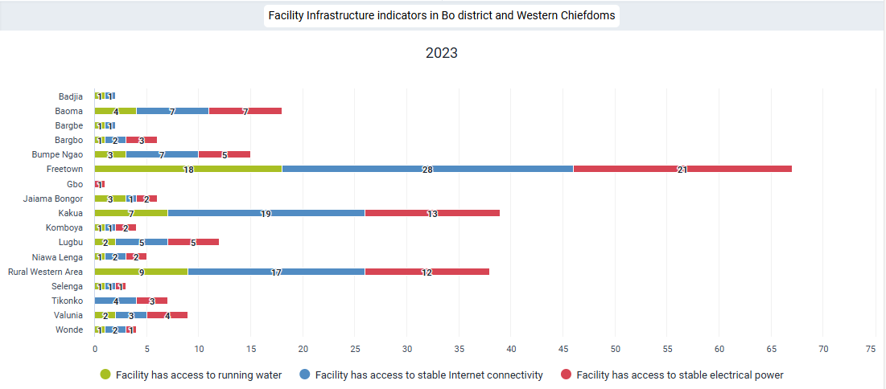
This horizontal stacked bar chart, illustrates the distribution of infrastructure access across various locations. Each bar is segmented into three categories:
Facility access to running water (green segment).
Facility access to stable Internet connectivity (blue segment).
Facility access to stable electrical power (red segment).
Key Details:
Y-Axis: Lists the locations being analyzed (e.g., Badjia, Baoma, Freetown, etc.)
X-Axis: Represents the number of facilities with access to the mentioned infrastructure types

Slide 28
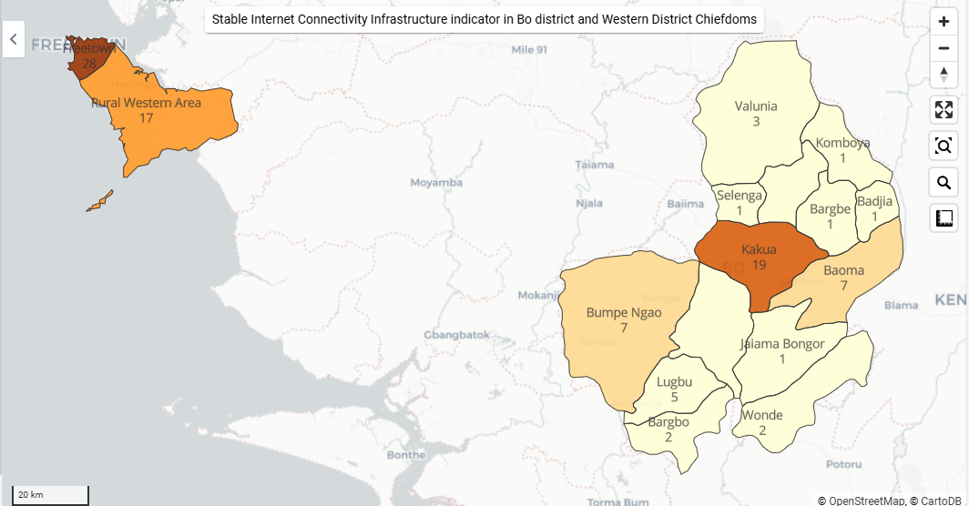
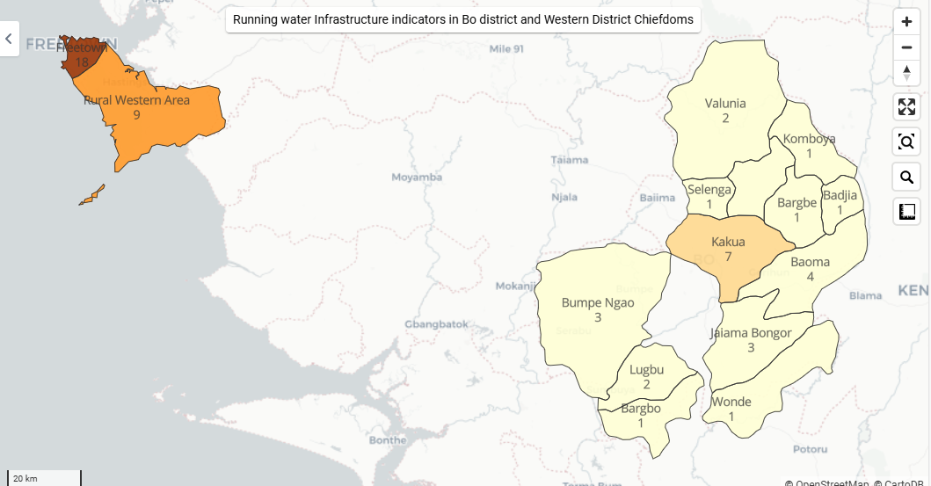
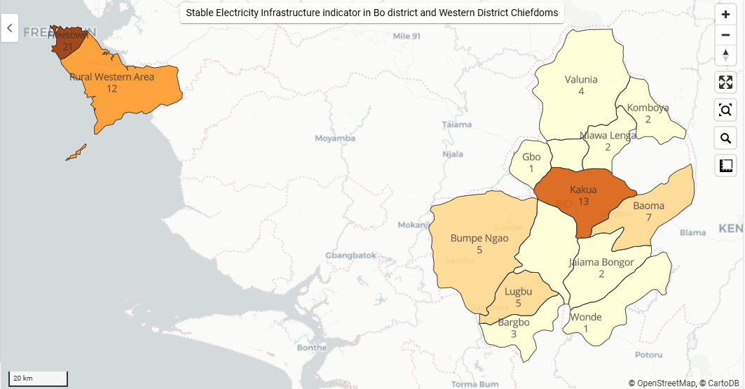
Three thematic maps, each representing a different facility infrastructure indicator in Bo and Western Area districts
Access to Running Water: Regions with darker shades have better access to running water, while lighter shades indicate limited access.
Access to Stable Internet Connectivity : Displays regional variations in Internet access, with darker regions showing higher connectivity levels.
Access to Stable Electrical Power : Highlights access to electrical power, with darker shades indicating regions with better infrastructure compared to those with lighter shades, which are underserved.

Slide 29
Analysis
Freetown:
Most facilities have access to all three types of infrastructure, especially Internet connectivity (28 facilities), running water (18 facilities), and electrical power (21 facilities). This highlights Freetown as the most developed region in terms of infrastructure.
Regions with Moderate Access:
Kakua: Facilities show significant access to Internet connectivity (19) but lower levels for running water and electric power.
Rural Western Area:
Exhibits moderate access to all three infrastructure types, with Internet connectivity (17) being the highest.
Regions with Limited Access:
Locations such as Badjia, Selenga, Wonde, and Bargbo have very low counts across all three categories, suggesting severe infrastructural challenges.
Infrastructure Gaps:
Stable electrical power (red segment) is frequently the least available across locations.
Access to running water (green segment) is also limited in several regions, indicating a critical area for improvement.

Slide 30
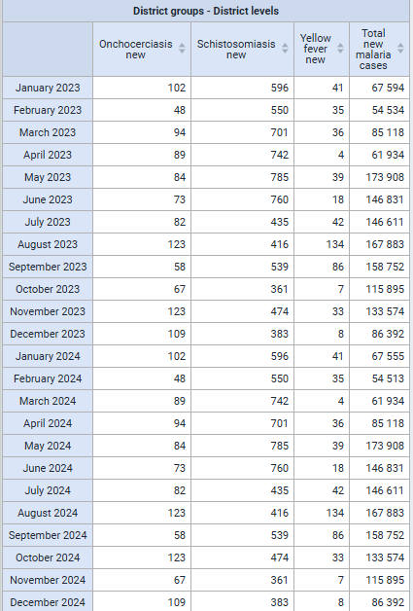
Prepare a table with all the new cases (data elements) for each month of 2023 and 2024 by the district. By using ANOVA, test the hypothesis that the occurrence of Malaria (using treated as a conduit) is predictable from the occurrence of other vector-borne diseases.
Procedure:
In the "Data Visualizer" App in DHIS2
Data:
Data Item: "Data Elements"
Schistosomiasis new
Yellow fever new
Onchocerciasis new
Malaria treated new =
Calculation:
Malaria treated at PHU with ACT < 24 hrs new +
Malaria treated at PHU with ACT > 24 hrs new +
Malaria treated at PHU without ACT < 24 hrs new +
Malaria treated at PHU without ACT > 24 hrs new +
Malaria treated in community with ACT <24 hrs new +
Malaria treated in community with ACT >24 hrs new +
Period: Fixed Period – Monthly – January 2023 -December 2024
Organization Unit: Sierra Leone
Visualization: Pivot Table
Notes:
Data visualizer app, under data, data elements were selected as data types and new cases in data elements group. Under fixed period, all months of 2023 and 2024 were selected.
Below are the vector borne diseases in the resulted dataset -
Malaria
Yellow fever
Schistosomiasis
Onchocerciasis
Below are the variables related to malaria, there are 6 different group of variables based on –
Different treatment time:
With or without ACT
Treated in community or PHU.
Therefore, these variables are merged together with their aggregate values.
Malaria treated at PHU with ACT < 24 hrs new
Malaria treated at PHU with ACT > 24 hrs new
Malaria treated at PHU without ACT < 24 hrs new
Malaria treated at PHU without ACT > 24 hrs new
Malaria treated in community with ACT <24 hrs new
Malaria treated in community with ACT >24 hrs new
Reference link for vector borne diseases: https://www.who.int/news-room/fact-sheets/detail/vector-borne-diseases
Analysis of disease surveillance data from April 2023 to September 2024 across Sierra Leone reveals significant patterns in the distribution of four major diseases. Malaria emerges as the most prevalent health concern, with approximately 2.8 million cases reported during this period. In comparison, Schistosomiasis affected 13,484 individuals, while Onchocerciasis and
Yellow fever showed lower incidence rates with 2,104 and 966 cases respectively. Regional analysis highlights substantial variations in disease burden, with Bo district recording the highest number of malaria cases (456,496) and yellow fever infections (482). The Western Area follows closely with 483,638 malaria cases, while Kenema district stands out for having the highest incidence of both Onchocerciasis (564 cases) and Schistosomiasis (5,194 cases). In contrast, Bonthe district consistently reported the lowest disease burden across most categories, with just 10 Onchocerciasis cases, 8 Schistosomiasis cases, and 55,284 malaria cases. Moyamba district notably reported no yellow fever cases and only 4 cases of Onchocerciasis. The data suggests a pattern where coastal regions generally experience lower rates of Onchocerciasis and Schistosomiasis, while urban areas, particularly the Western Area, show high malaria prevalence but lower numbers of other diseases.

Slide 31
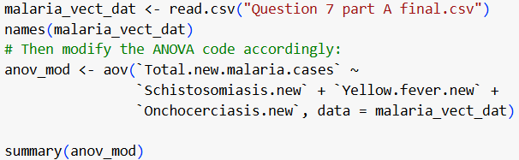
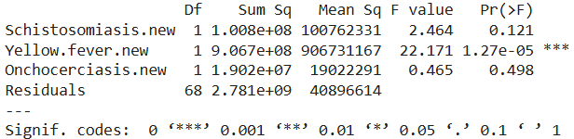
Hypotheses:
H0: vector diseases are independent from malaria.
Ha: vector diseases case number can predict number of malaria.
Test Assumptions:
Observations are independent
Normal distribution of residuals
Homogeneity of variance
Run ANOVA:
Interpretation of ANOVA results:
Since yellow fever is significant, the null hypothesis can be rejected.
This suggests that there is an association between the number of new malaria cases when considering this disease.

Slide 32
Create a line chart of new cases of Clinical malnutrition, Diarrhoea with blood (dysentery), diarrhea with severe dehydration, diarrhea without severe dehydration - for the last 1 year in all of Sierra Leone. Describe the correlation that you may see between these diagnoses with the appropriate chart.

Slide 33
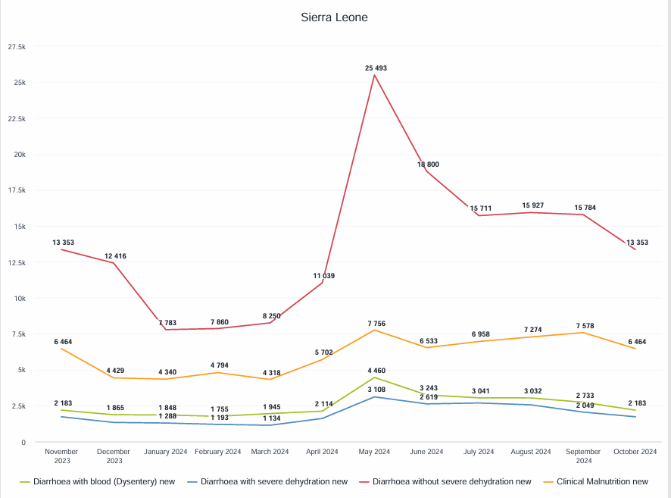
There is a correlation between all cases of diarrhea and clinical malnutrition. The number of cases slightly decreases in December, gradually increases over the following months, peaks in May, and then begins to decline steadily.

Slide 34
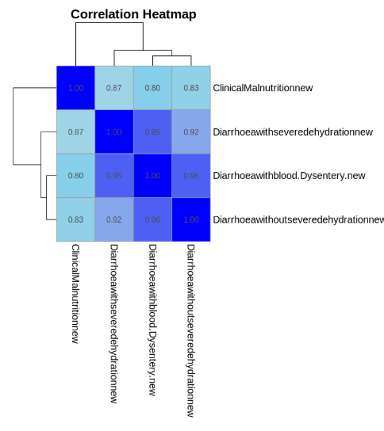
Correlation matrix​
All variables have strong positive correlations with one another.
The strongest correlation is between Diarrhoeawithblood(Dysentery) and Diarrhoeawithoutseveredehydration (0.96)
It is deal for quantifying relationships between multiple variables, providing precise numerical measures of association.

Slide 35
Sentiment analysis of team opinions on the two visualizations, including preferences for specific chart types.

Slide 36
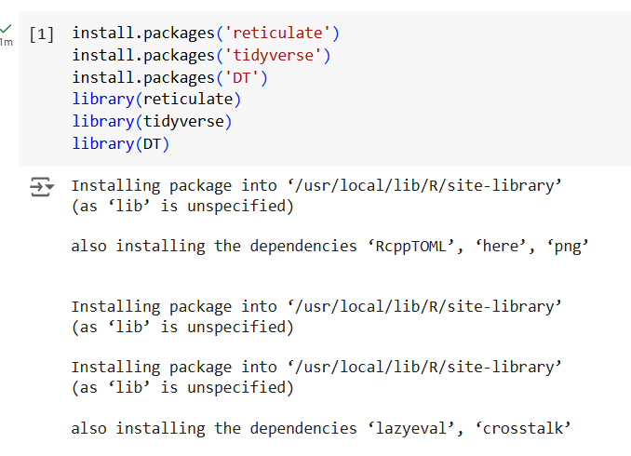
We used the reticulate package to perform sentimental analysis of the team's opinions

Slide 37
Cont......
Question 3
Positives | 11
Negatives | 10
Average Score | 0.938
Conclusion: The map preference for the group members is predominantly positive with an average confidence score of 0.938
Question 8
Positives | 15
Negatives | 6
Average Score | 0.949
Conclusion: The line chart preference for the group members is predominantly positive with an average confidence score of 0.949.

Slide 38
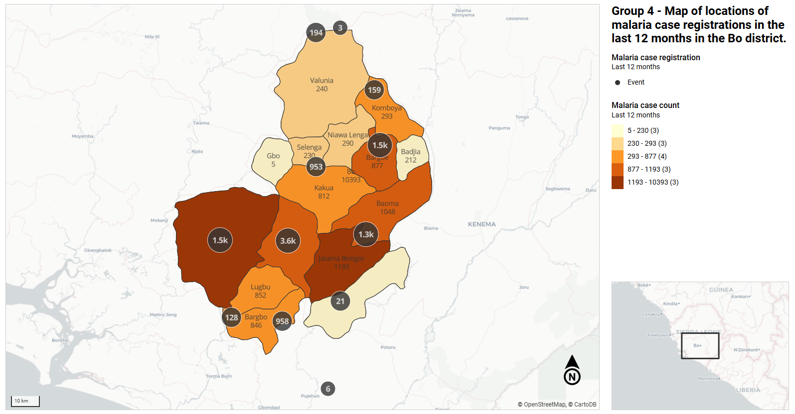
Create a map of locations of malaria case registrations in the last 12 months in the Bo district. 2. Create another map of Inpatient morbidity and mortality over the last 12 months in Bo district. Using these maps as images, and a clustering algorithm, describe the clusters and their relationship within a map or between the two maps using any nearness metric.
Notes:
The map shows that malaria cases are unevenly distributed across Bo district, with the highest numbers (over 10,000 cases) concentrated in the central-western region. While some areas like Gbo report very few cases (just 5), others like Baoma record over 1,000 cases. The northern areas generally show lower numbers, with
Valunia reporting 240 cases. There's a clear clustering of high-case areas in the central and western parts of the district, while the outer regions typically show lower numbers. The most concerning areas report between 1,193-10,393 cases, highlighting significant hotspots that may require targeted intervention. This substantial variation in case numbers between neighboring areas suggests there may be local factors influencing malaria transmission that warrant further investigation.
Item type – program indicators
Program – malaria case registration
Program indicator – malaria case count
Aggregation type - count

Slide 39
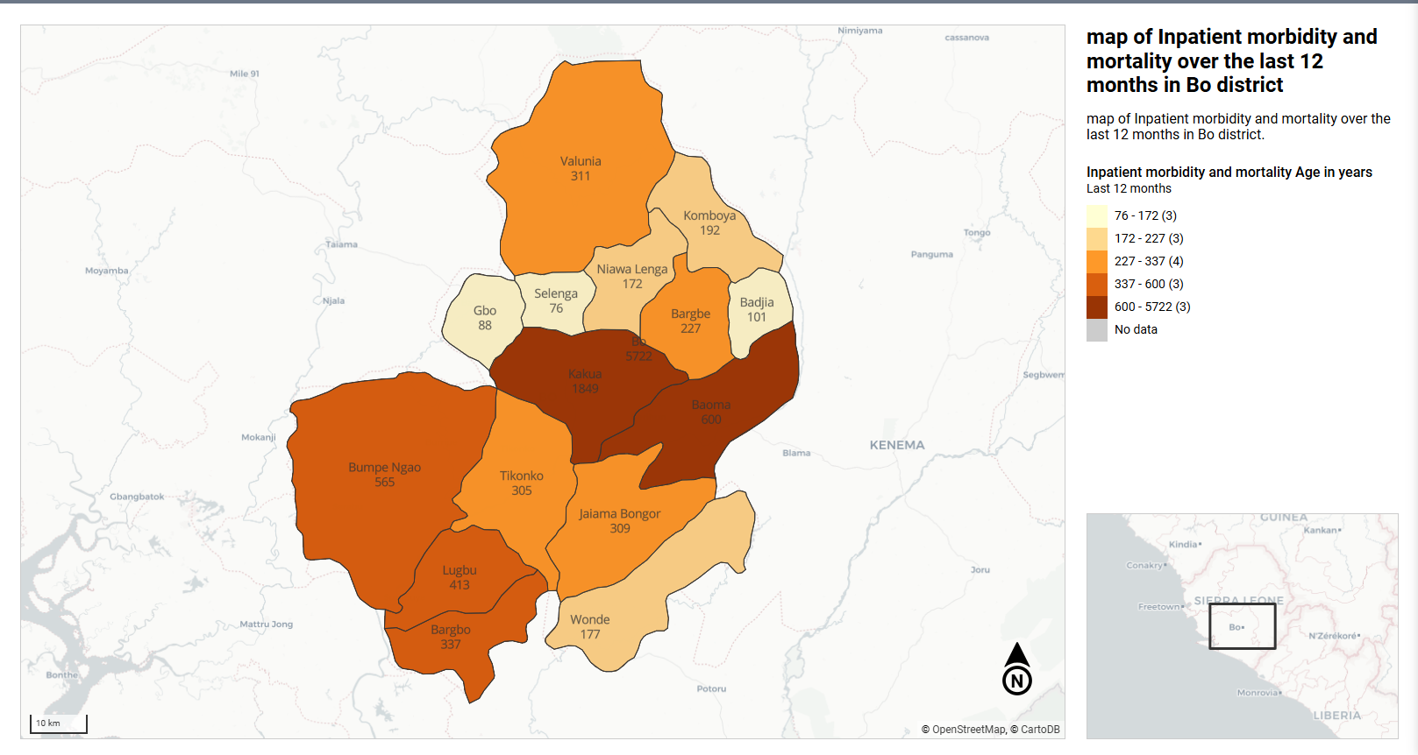
Notes:
The map reveals significant variations in inpatient cases across Bo district over the last 12 months. Kakua region records the highest number with 1,849 cases, followed by Baoma (600) and Bumpe Ngao (565). In contrast, regions like Gbo and Badjia report much lower numbers at 88 and 101 cases respectively.
Most other areas show moderate rates ranging between 300-400 cases. This pattern suggests a concentration of health challenges or healthcare utilization in the central regions, while peripheral areas generally report lower numbers. The stark variations between neighboring regions might indicate differences in healthcare access, population density, or reporting practices.
Item type – Event data items
Program – Inpatient morbidity and mortality
Event data item – inpatient morbidity and mortality age in years
Aggregation type – count

Slide 40
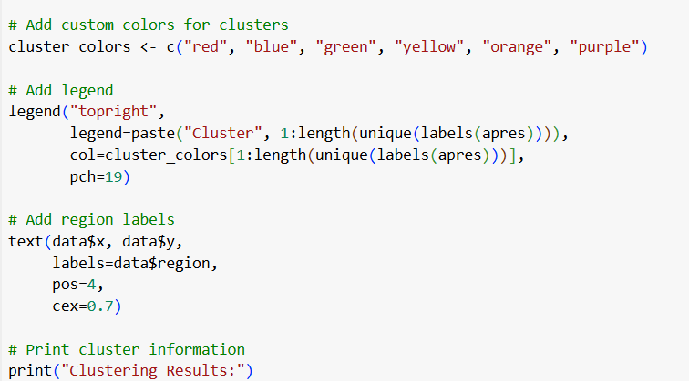
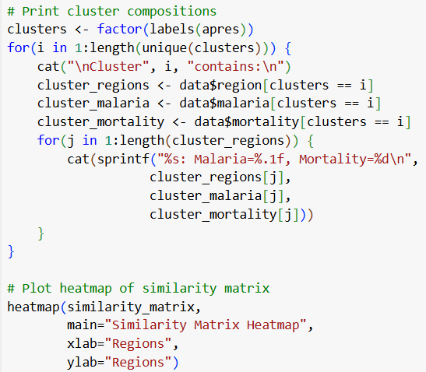
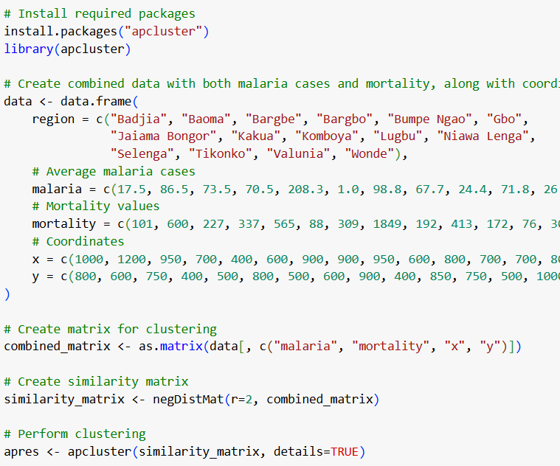

Slide 41
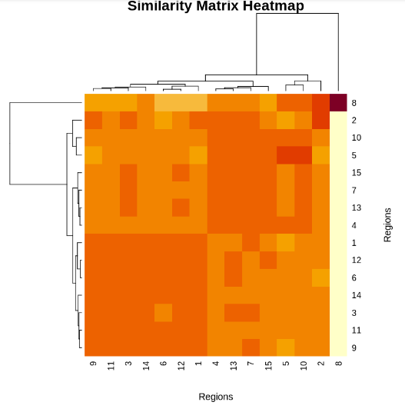
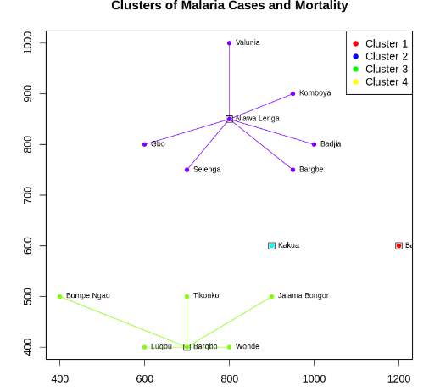

Slide 42
Interpretations of clustering analysis:
Cluster Identification
4 distinct clusters identified using apcluster in R
Clusters reveal both geographic and health-metric patterns
Single exemplars (Baoma, Kakua) represent unique risk areas
Critical Hotspots
Kakua: Highest mortality (1849) despite moderate malaria cases
Bumpe Ngao: Highest malaria cases (208.3)
Northern regions show consistently better health outcomes
Key Findings
Weak correlation (0.334) between malaria cases and mortality
Geographic proximity influences cluster formation
Northern cluster practices could provide valuable lessons
Implications
Targeted interventions needed for different clusters
Resource allocation should consider both geographic and health metrics
Success factors in northern regions warrant further investigation
This clustering analysis enables evidence-based decision-making for healthcare resource distribution and intervention strategies.
Notes:
Based on our analysis of the Bo district data using Affinity Propagation (apcluster package in R), here are the key insights:
We have used Affinity Propagation (apcluster package in R), a machine learning technique, which has allowed for the identification of distinct clusters of different regions based on both malaria cases and mortality rates within the Bo district.
4 significant clusters have been identified:
Single-region clusters (Baoma and Kakua) representing unique exemplars with extreme values
A northern cluster with 7 regions showing consistently lower rates
A southern/western cluster with 6 regions showing variable patterns Each cluster acts as a potential focus point for targeted healthcare interventions and resource allocation.
The spatial distribution of clusters outlines critical health hotspots:
Kakua emerging as a critical mortality hotspot (1849 deaths)
Bumpe Ngao as a significant malaria case hotspot (208.3 cases)
Northern regions demonstrating better health outcomes This spatial understanding is essential for directing medical resources and attention.
The analysis facilitates several key insights:
Weak correlation (0.334) between malaria cases and mortality suggests other influencing factors
Geographic proximity appears more influential in cluster formation than health metrics
Identification of successful regions (northern cluster) provides learning opportunities These patterns could be instrumental in developing targeted interventions and preventive strategies in high-risk zones.

Slide 43
Thank you
Questions?

Slide 44
Appendix
Question 1b
https://colab.research.google.com/drive/1GVMQqkvVkjFWS6UzQWgMd7LR84jDohVj?usp=sharing
Question 4: https://colab.research.google.com/drive/1A8OSSAFvofNl2viGkFoDuLYrXgCC1p5H?usp=sharing
Question 5: https://colab.research.google.com/drive/17weDzu0nXxd9770XOaE7Vn7h4ZtAGP34?usp=sharing
Question 7 and Question 10: https://colab.research.google.com/drive/1iUOpHqs-Moii4eTgSSHb24ci9Zs546pe?usp=sharing
Question 8: https://colab.research.google.com/drive/1uAAoKqSvoTbcqQbrSue2Vskr73AdESuP?usp=sharing

Slide 45
Cont....
Question 9: https://colab.research.google.com/drive/1eON7lETmEcjwnGzTR55z8JAJZl1rOFT2?usp=sharing
Xian, X., Wang, L., Wu, X., Tang, X., Zhai, X., Yu, R., Qu, L., & Ye, M. (2023). Comparison of SARIMA model, Holt-winters model and ETS model in predicting the incidence of foodborne disease. BMC Infectious Diseases, 23(1). https://doi.org/10.1186/s12879-023-08799-4

